Slide 1
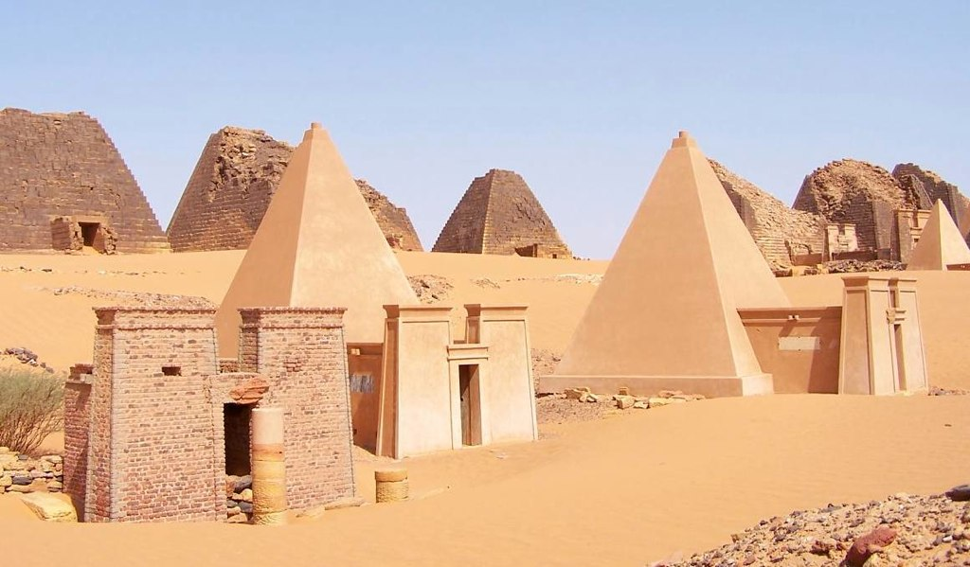
Insights into the Meroitic Civilization:
Piankhi, Taharqa, Amanitore, and Apademak
Momshad Fadul
03.13.2024

Slide 2
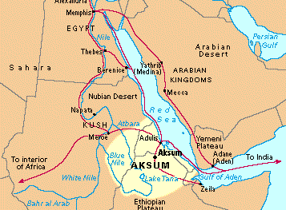
Introduction to the Meroitic Civilization
The Kingdom of Meroe was one of the most remarkable civilizations that flourished in the Nubian region (modern-day northern Sudan between 800 BCE and 350 CE. Meroe served as the capital of the Kushite Kingdom
Meroe was a key cultural and political center in ancient Northeast Africa, known for its military power and cultural influence.
Religiously, Meroe combined local Nubian beliefs with Egyptian traditions, worshipping deities such as Amun, Apedemak, and Isis.

Slide 3
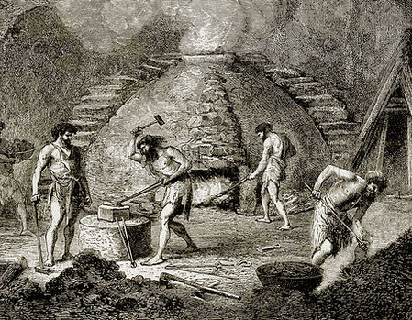
Iron Production and Its Importance in Meroe
Pioneers in Ironworking: Meroe was one of the first civilizations to master iron smelting and use it in tools and weapons.
Impact: The mastery of iron contributed to Meroe’s economic and military strength.

Slide 4
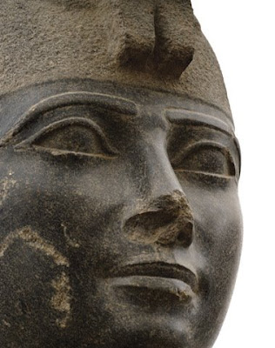
Piankhi - The Great King (8th Century BCE)
He is renowned for unifying Egypt under his rule and establishing the 25th Dynasty, often referred to as the “Kushite Dynasty.” His reign marked a significant period in ancient history, where the power and influence of Nubia extended far into Egypt.
Key Achievements of Piankhi:
Conquest of Egypt: Around 730 BCE, Piankhi launched a military campaign to reunify Egypt, which had been fragmented into various smaller kingdoms.
Religious Devotion: Piankhi was a deeply religious leader who believed he was chosen by the god Amun to rule.
Cultural Influence: His reign symbolized a fusion of Nubian and Egyptian traditions, reflected in art, architecture, and governance. Piankhi's reign is remembered as a time of cultural renaissance and political unity, showing casing the strength and sophistication of the Kushite civilization. His achievements underline the historical importance of Nubia in shaping the ancient world.

Slide 5
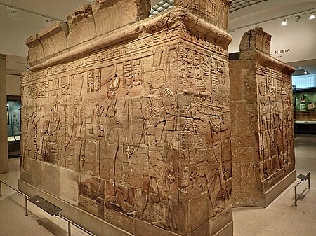
King Taharqa (690-664 BCE)
Taharqa: The Pharaoh of the 25th Dynasty (690–664 BCE) was one of the most prominent rulers of the 25th Dynasty of Egypt, often referred to as the "Kushite Dynasty." He was the son of King Piankhi ​
• Led successful military campaigns defending both Kush and Egypt against the Assyrians.​
• undertook massive building projects in both Egypt and Nubia.​
• His story is preserved in Egyptian temples, Nubian pyramids, and Assyrian records. ​
Some of Taharqa's Principles
"I do not listen to falsehood": A commitment to listening to the truth and rejecting rumors.
​"I do not lie": Emphasizing honesty and integrity in dealing with others.​
"I do not do evil": Avoiding unethical actions.​
"I do not associate with the wicked": Refusing to build relationships with corrupt individuals.​
"I do not leave the wrongdoer unpunished": Ensuring justice and holding wrongdoers accountable.​
​ These principles made Taharqa a wise and respected leader.​

Slide 6
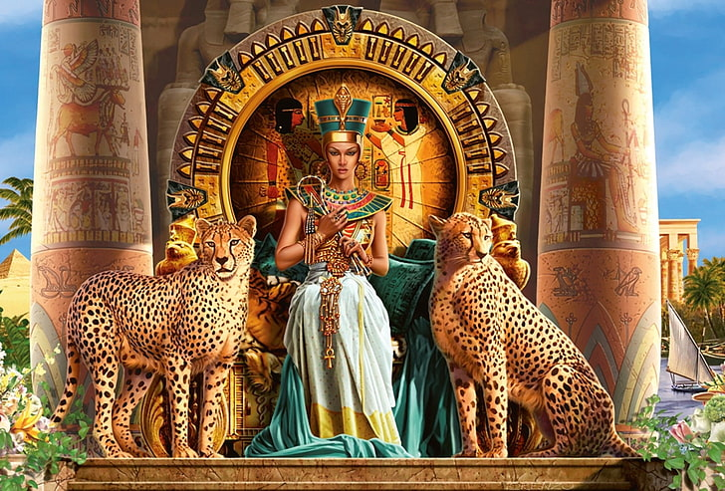
Queen Amanitore - A Powerful Kandake
Queen Amanitore was one of the greatest Kandakes (Nubian Queens), leading the Kingdom of Meroe with wisdom and strength.
She symbolized female strength and was a key figure in maintaining the stability of the Kingdom of Kush.
Diplomatic Relations: Amanitore's reign was marked by wise political strategies and strong relationships with neighboring regions.
Co-ruled with her husband King Natakamani, a common practice in Meroitic governance, emphasizing the balance of power between genders in Kushite society.
She revitalized religious practices and celebrated the worship of Amun and Apedemak, the lion-headed god of war.
Her pyramid at Meroe stands as a testament to her enduring legacy, symbolizing the rich cultural and architectural heritage of the Kingdom of Kush.
Queen Amanitore's reign highlights the role of women in Kushite society, where they often served as rulers, military leader, and spiritual figure.

Slide 7
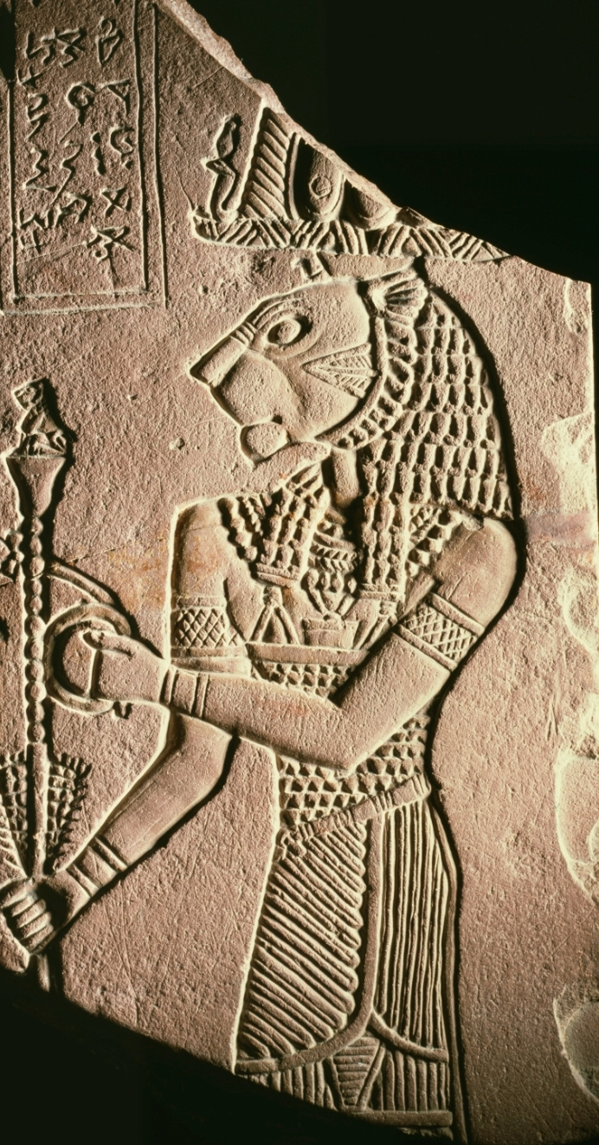
Apademak - The God of War
Apademak was depicted as a lion-headed god, representing strength, courage, and protection.
Apedemak was a prominent deity in the religion of the Kingdom of Meroe and the wider Kushite civilization. Known as the lion-headed god, Apedemak symbolized strength, war, protection, and kingship, and he played a central role in the religious and cultural identity of the Nubian people.
Kings of Meroe associated themselves with Apedemak to emphasize their strength and divine approval.
Apedemak represented the unique identity of the Kushite people, distinguishing their religion from that of ancient Egypt.
The most famous rededication to the God is Apadmak, located in Naqa, featuring amazing drinks for the God.

Slide 8
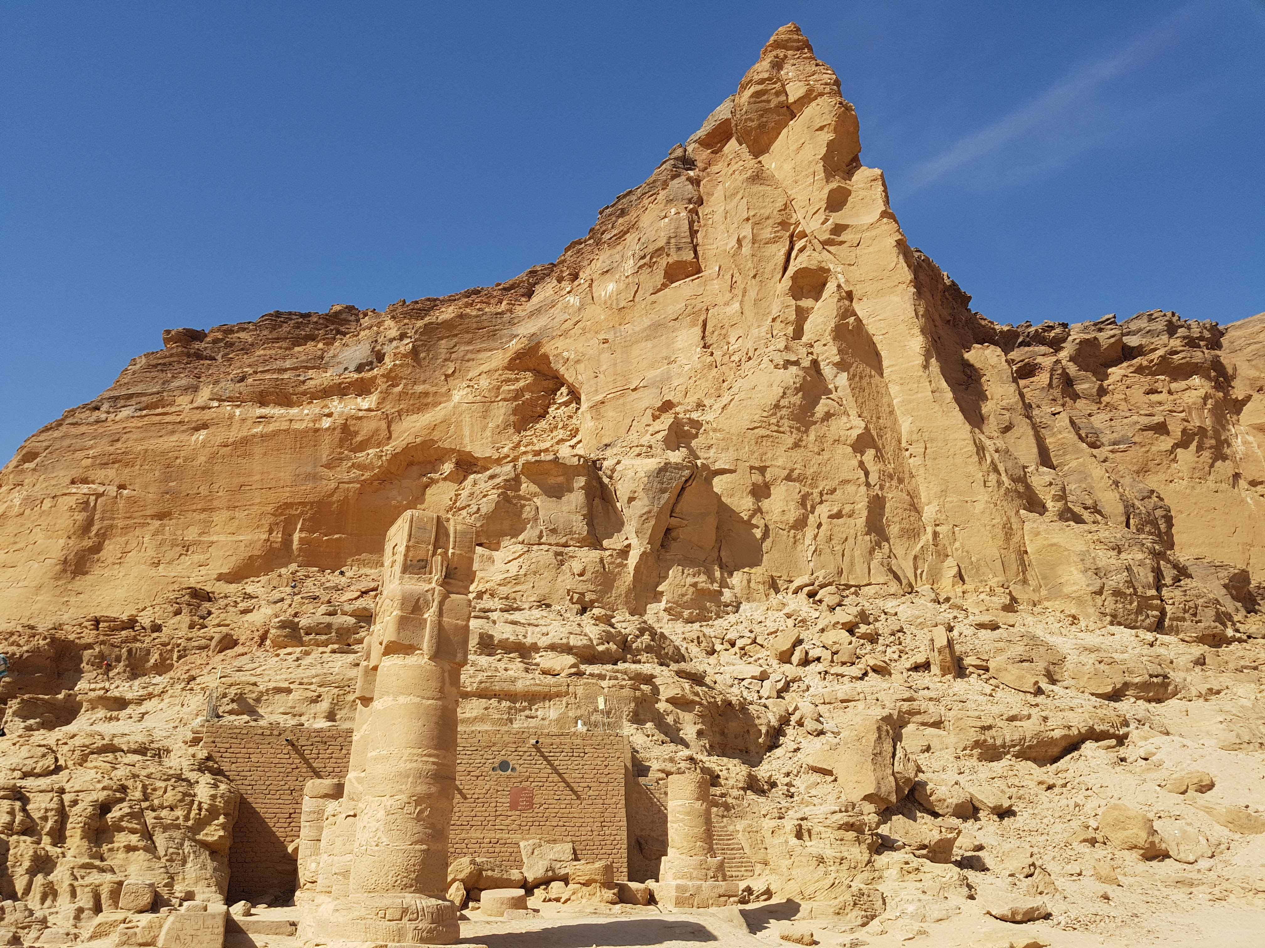
The Sacred Mountain - Jebel Barkal
Jebel Barkal is located on the west bank of the Nile, near the ancient city of Napata.
It was considered a sacred site, associated with the god Amun.
The mountain symbolized divine power and was the place where many Kushite kings were crowned and buried.
home to several important temples, including the Temple of Amun.
UNESCO World Heritage Site: In 2003, Jebel Barkal and the surrounding archaeological sites were designated as a UNESCO World Heritage Site for their historical and cultural significance.

Slide 9
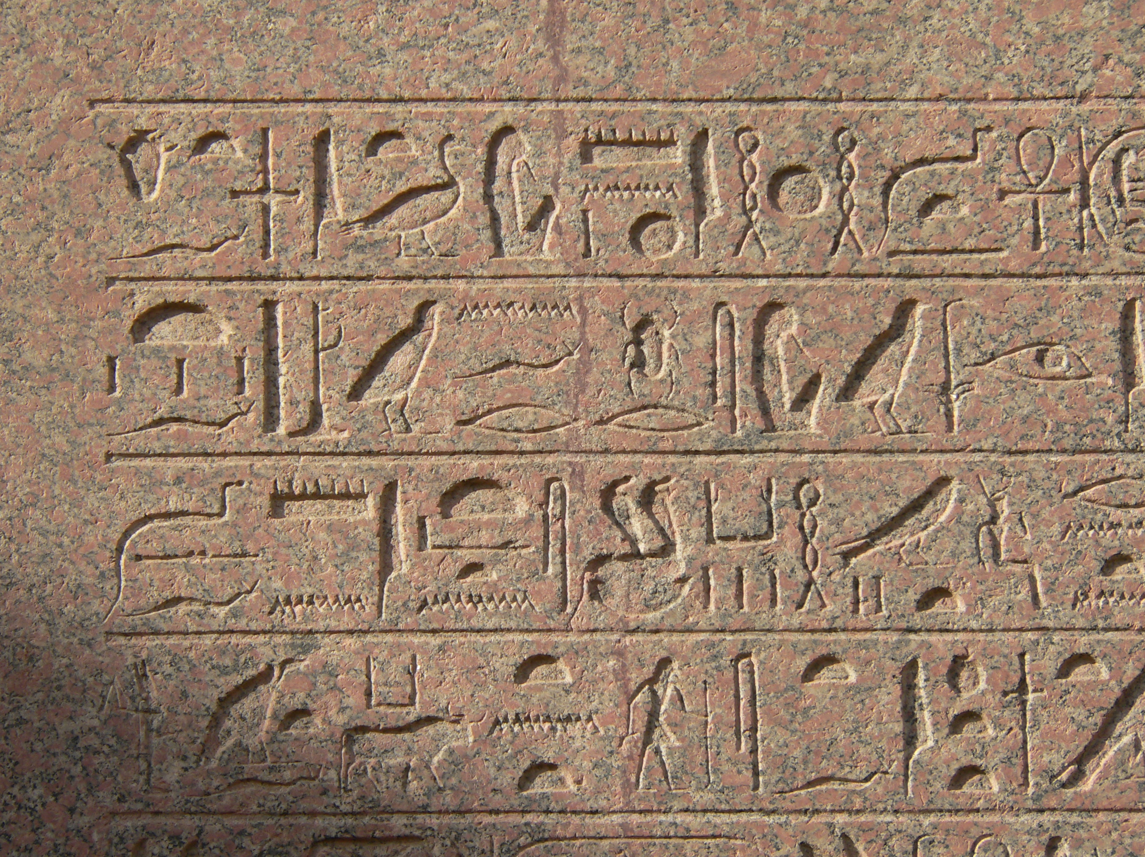
Legacy of Meroe and Its Cultural Impact
Architectural Achievements: Meroe is famous for its pyramids and temples.
Writing: The Meroitic script remains an important part of the kingdom’s cultural legacy.

Slide 10
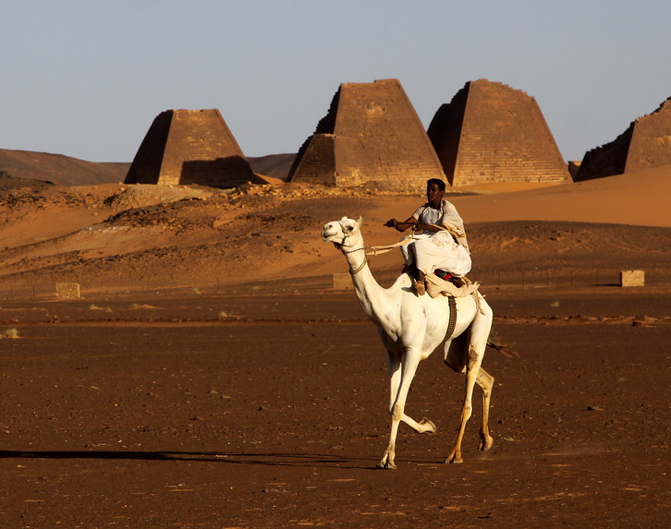

Conclusion
Summary: The Kingdom of Meroe and its leaders, such as Piankhi, Taharqa, Amanitore, and Apademak, left behind an extraordinary cultural and political legacy.
Thank you!

